Slide 1

Adaptation and Extension of DeepCellMap to the ImmuCAN Dataset
Ali Ahmadi
Data Analytics Biomarker Team
June to December 2025

Slide 2
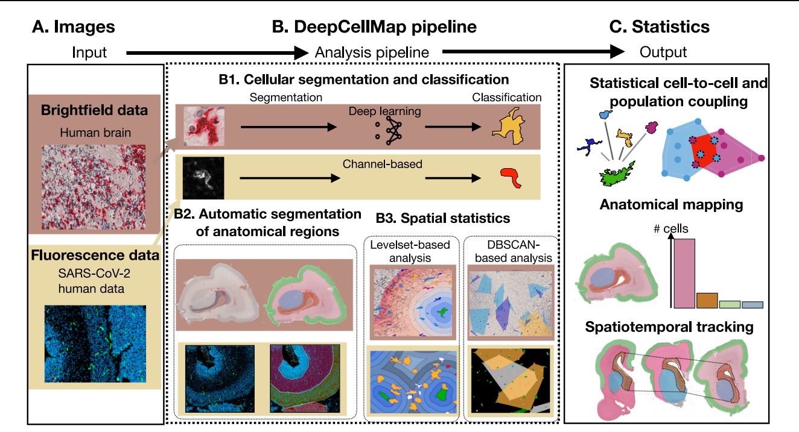
What is DeepCellMap? DeepCellMap is an open-source tool to Investigate the spatial distribution of cells in digital pathology and extract organizational patterns,
1.Image Preprocessing
2. Cell Segmentation & Classification
3. ROI System
4. Statistical Analysis

Slide 3
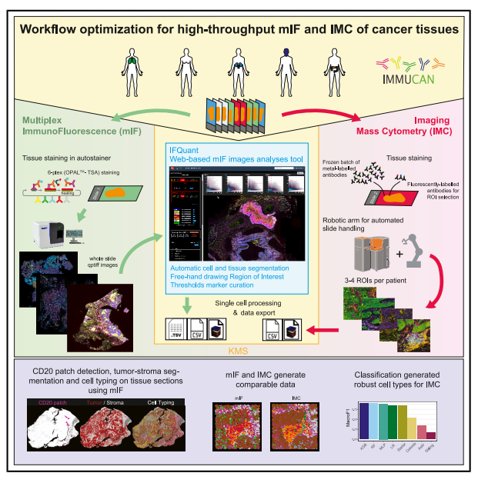
What is IMMUCAN Dataset? IMMUCAN is a large immuno-oncology project analyzing immune–cancer interactions using samples from ~3,000 patients across several cancer types (colorectal, lung, head & neck, breast, gastric, renal).
Key Characteristics:
Multi-cohort design (BC1, BC2, BC3…)
Each slide has 3 IF rounds (IF1 / IF2 / IF3)
Contains multiple image resolutions (page RGB, others = channels)
Accompanied by multiple TSV and TSV.GZ metadata files:
Images stored as QPTIFF (Pyramidal TIFF)
phenotype strings (e.g., CD3+CD8−…)
spatial coordinates (nucleus x/y)
cell area

Slide 4
Project Motivation
What DeepCellMap Does
Reads TIFF/CZI mIF images
Segments nuclei & cells
Extracts per-cell features
Classifies cell types
Defines ROIs (tile-based)
Computes spatial statistics (colocalisation, neighborhood, levelsets)
➡️ DeepCellMap is powerful, but requires major adaptation before it can be applied to the ImmuCAN dataset.
Limitations for ImmuCAN
Uses TIFF/CZI, not QPTIFF
No TSV input support
Different metadata structure
No phenotype → cell type mapping
Cannot handle multiple IF rounds (IF1–IF3)
ImmuCAN images are much larger (50k×46k px)

Slide 5
Project’s Goals
Main Objective
Apply DeepCellMap methods to the ImmuCAN dataset
Study spatial relationships between cell types
Perform levelset & colocalisation analyses
Tasks Included
Read & display QPTIFF images/channels
Convert QPTIFF → TIFF-compatible format
Parse TSV files, clean them, generate cell types
Compute additional features (tile indices, coords)
Main Challenge
Understand DeepCellMap internals
Adapt its workflow to a new modality and new metadata format

Slide 6
Overview of Contributions
1. Data Engineering Layer
2. Image Layerer
3. Mask / Segmentation Layer
4. Integration With DeepCellMap
5. Analysis Layer

Slide 7
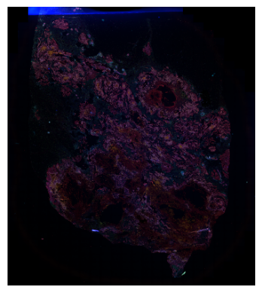
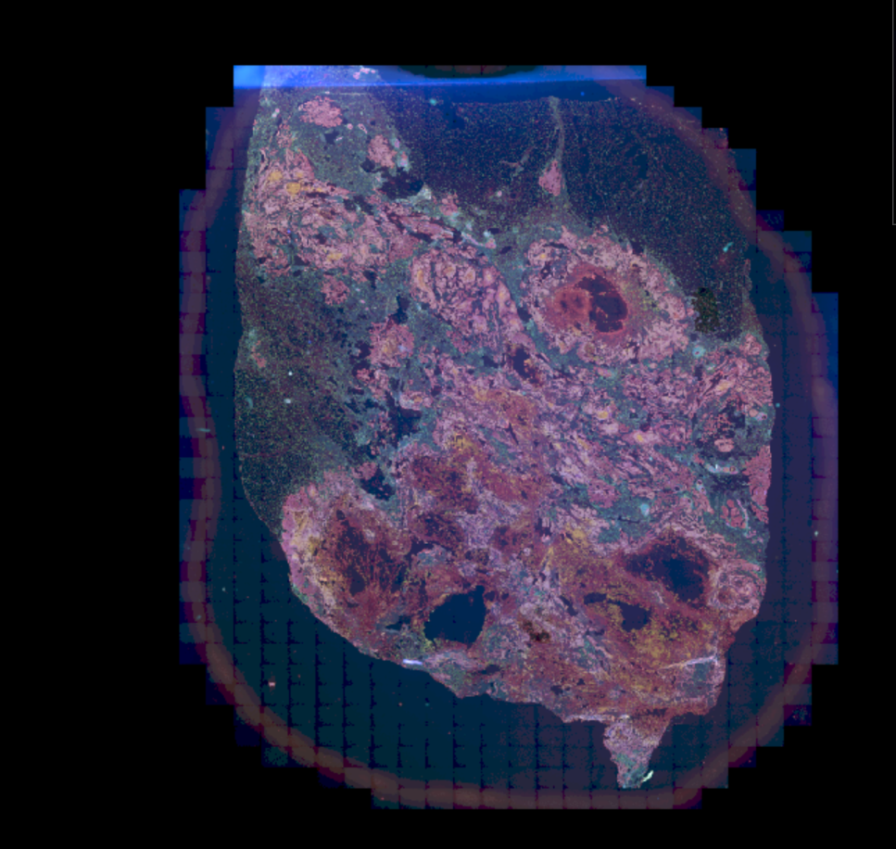
Image displaying by channel 8 of Qptiff by Tifffile library Python Original Image of BC1, IF1, 1140 with Qupqth
Displaying Image

Slide 8
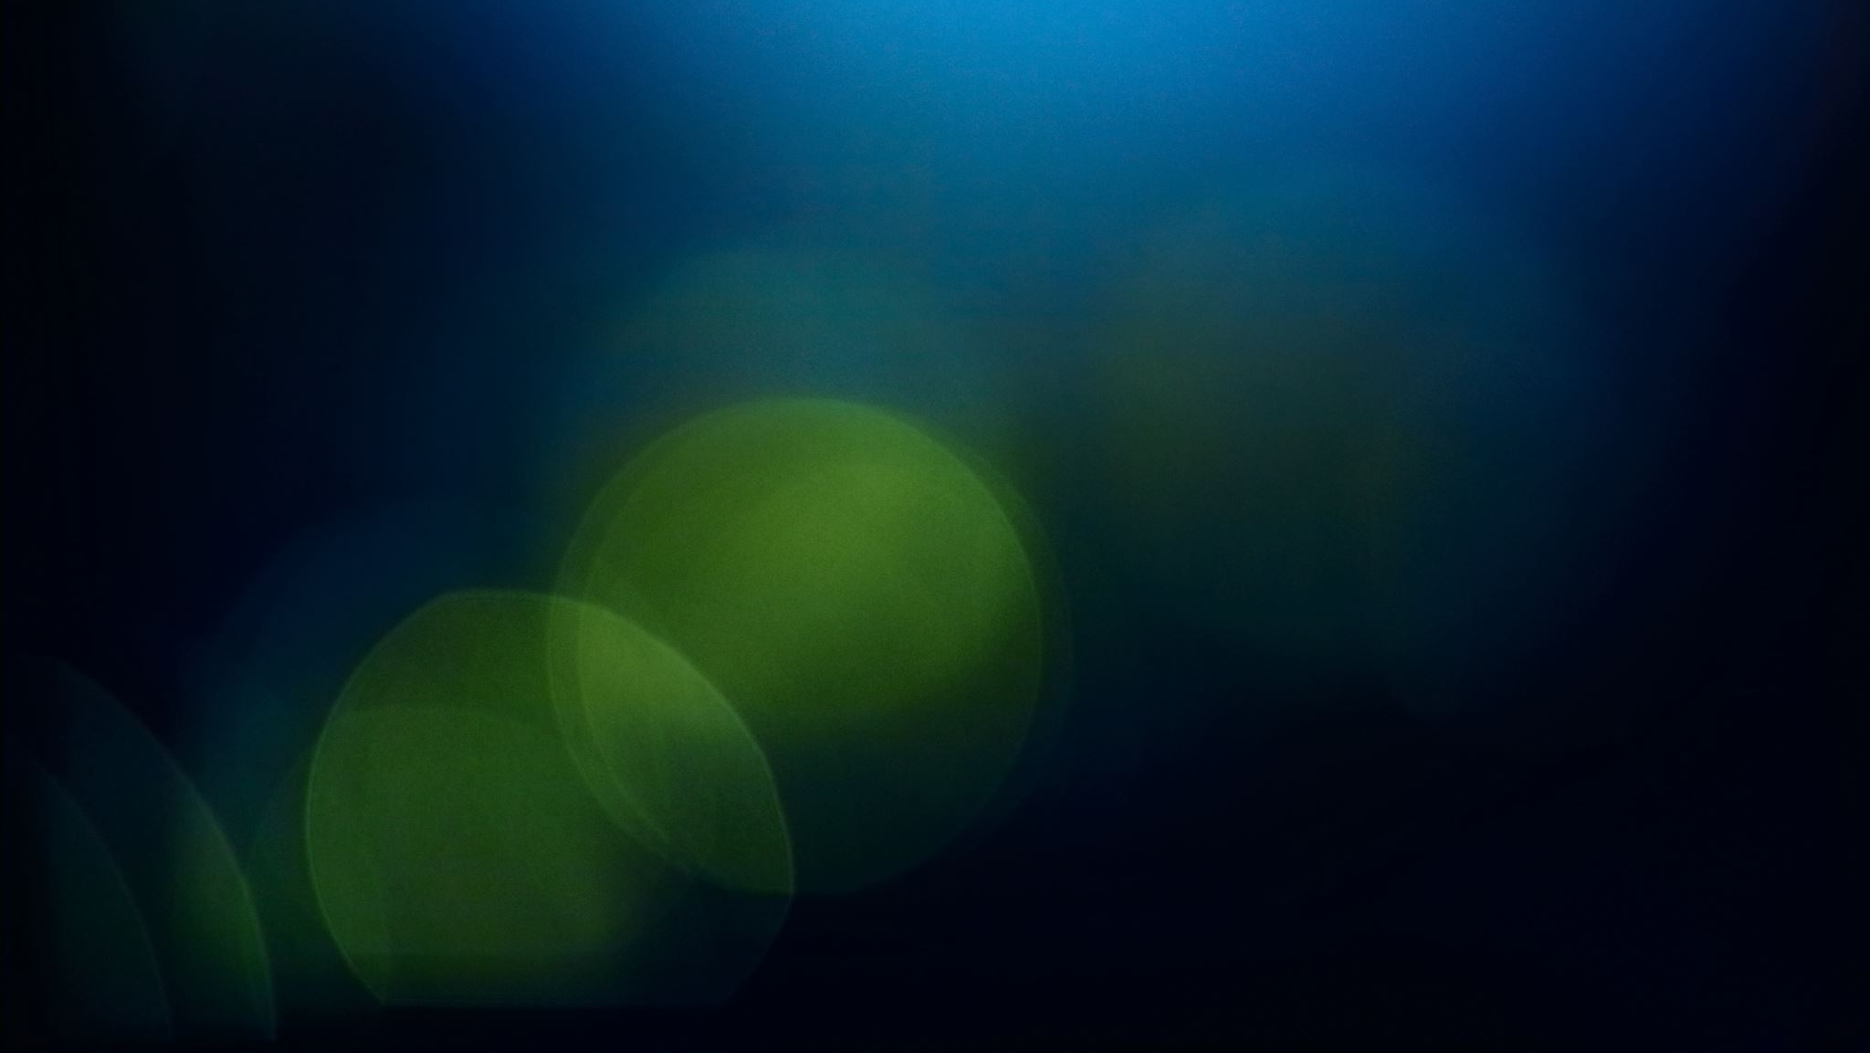
Data Preparation Pipeline
We needed Immucan dataframe matches DeepCellMap so we built:
concatenating_csvs()
calculating_celltypes_from_phenotypes()
calculatng_tiles()
label mapping (1–9 → B, BnT, DC, MacCD163, etc.)
generating one-hot encoded columns
unifying all metadata
Outputs:
A single CSV per slide with:
cell.ID
phenotype
Size
cell_type (1–9)
cell_type_name
x_img, y_img
tile_row, tile_col
x_tile, y_tile
area, length
one-hot cell-type columns
ROI flags
This exactly matches DeepCellMap’s expected input, but now based on ImmuCAN.

Slide 9
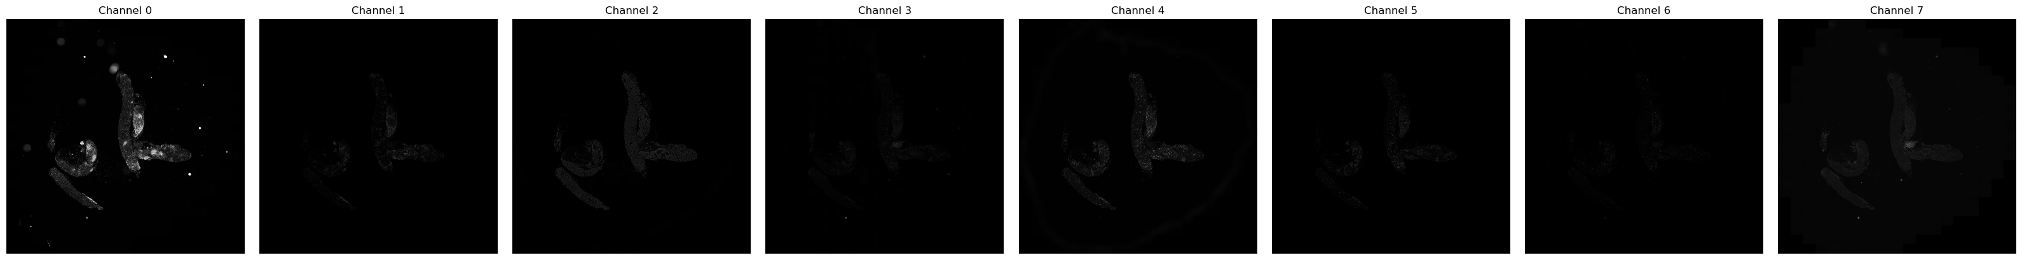
QPTIFF Loading
Displayed Multi channle Tiff after conversion from QpTiff
Read QPTIFF pages
Converting into multi Channel_Tiff
Store them in a dictionary
ROI cropping using _get_roi_w_borders_lims()
Special handling of grayscale vs RGB
Memory-optimized (out="memmap")

Slide 10
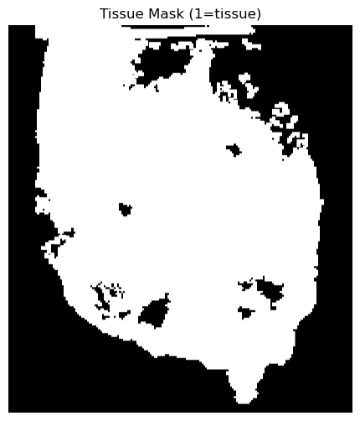
Creating Tissue Masks
Method A — From Theo Perrochon's preprocessing (H5 coords)
You reconstruct a full-resolution mask using patch coordinates.
Method B — From Autofluorescence Channel (Otsu)
You generate tissue mask directly from QPTIFF pages.
Method C — Old DeepCellMap masks imported & aligned
Modified version of get_mask_tissue_original.
Output:
➡️ ROI-aligned tissue mask saved as PNG ➡️ Used to filter cells and images

Slide 11
Table Cells Extraction
Reads unified CSV
Filters by ROI
Handles border extension
Removes cells duplicated across channels
Computes ROI coordinate for each cell
Produces output exactly in DeepCellMap’s expected format

Slide 12
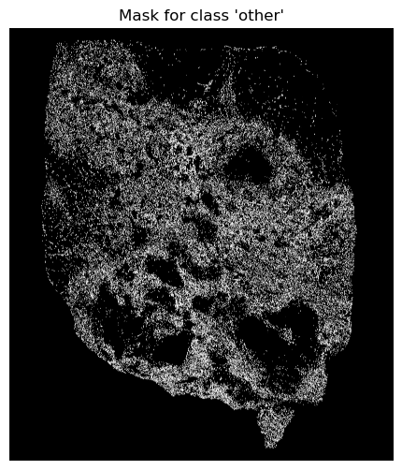
Cell Mask Generation
Before (DeepCellMap)
Uses segmentation model → probability maps.
My Approach (ImmuCAN)
No segmentation model → segmentation is replaced by:
Using each cell’s center (nucleus.x.px, nucleus.y.px)
Estimating radius using: r = sqrt(cell.area.px / π)
Drawing filled circle using PIL
Assigning integer class code
Using label priority (B → T → Tumor ...)
Cropping to ROI
Returning:
per-class boolean masks
label image
pixel counts per class
Include a visualization: ROI image + cell masks (color-coded)

Slide 13
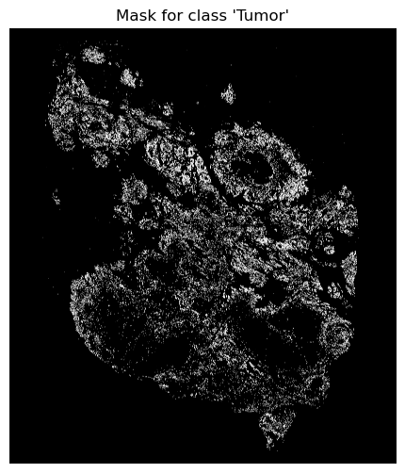
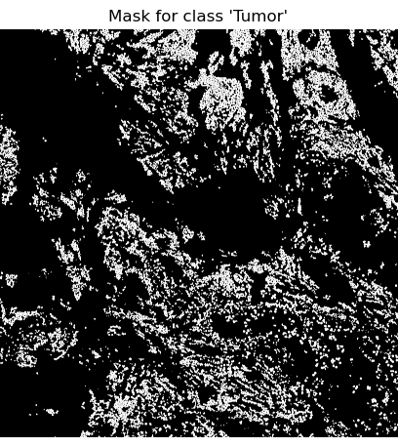

Slide 14
ROI & Border System
Filtering TSV based on x_img/y_img within ROI
1
Filtering border cells outside the ROI but inside border window
2
Computing x_roi_w_borders and y_roi_w_borders
3
Ensuring no doubled cells
4
Using pixel-level coordinates instead of tile-based indexes
5

Slide 15
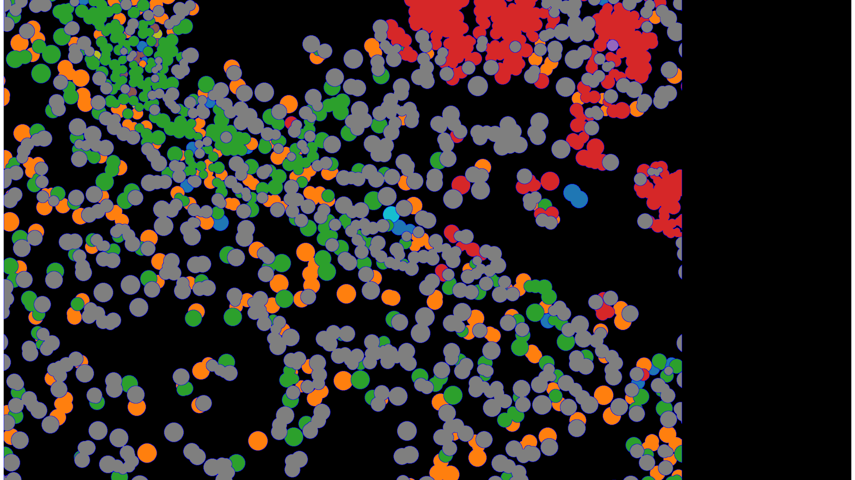
Full Pipeline
QPTIFF → Load Pages (0–8)
→ TSV Parsing
→ Phenotype → Cell Type Mapping
→ Merge & Build Full CSV
→ Compute Tiles & coordinates
→ Extract ROI(Table Cells)
→ RGB image
→ Tissue Mask Generation
→ Cell Mask Generation (PIL)
→ DeepCellMap Statistics
→ Colocalisation Analysis
→ DBSCAN Clustering
→ Cohort Results

Slide 16
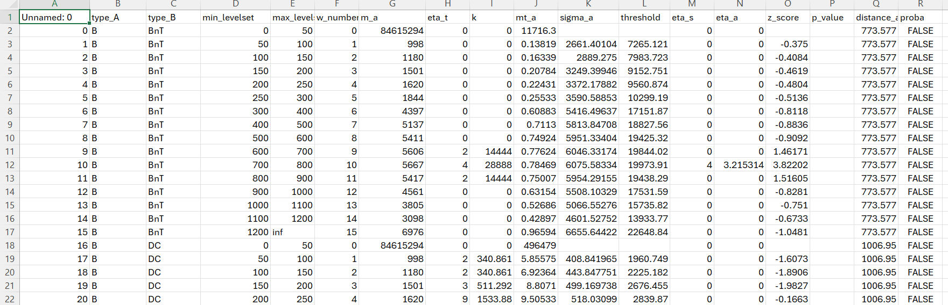
Colocalisation Analysis
Generates:
z-score heatmaps
pairwise colocalisation
distance distributions
A-in-B levelset visualization

Slide 17
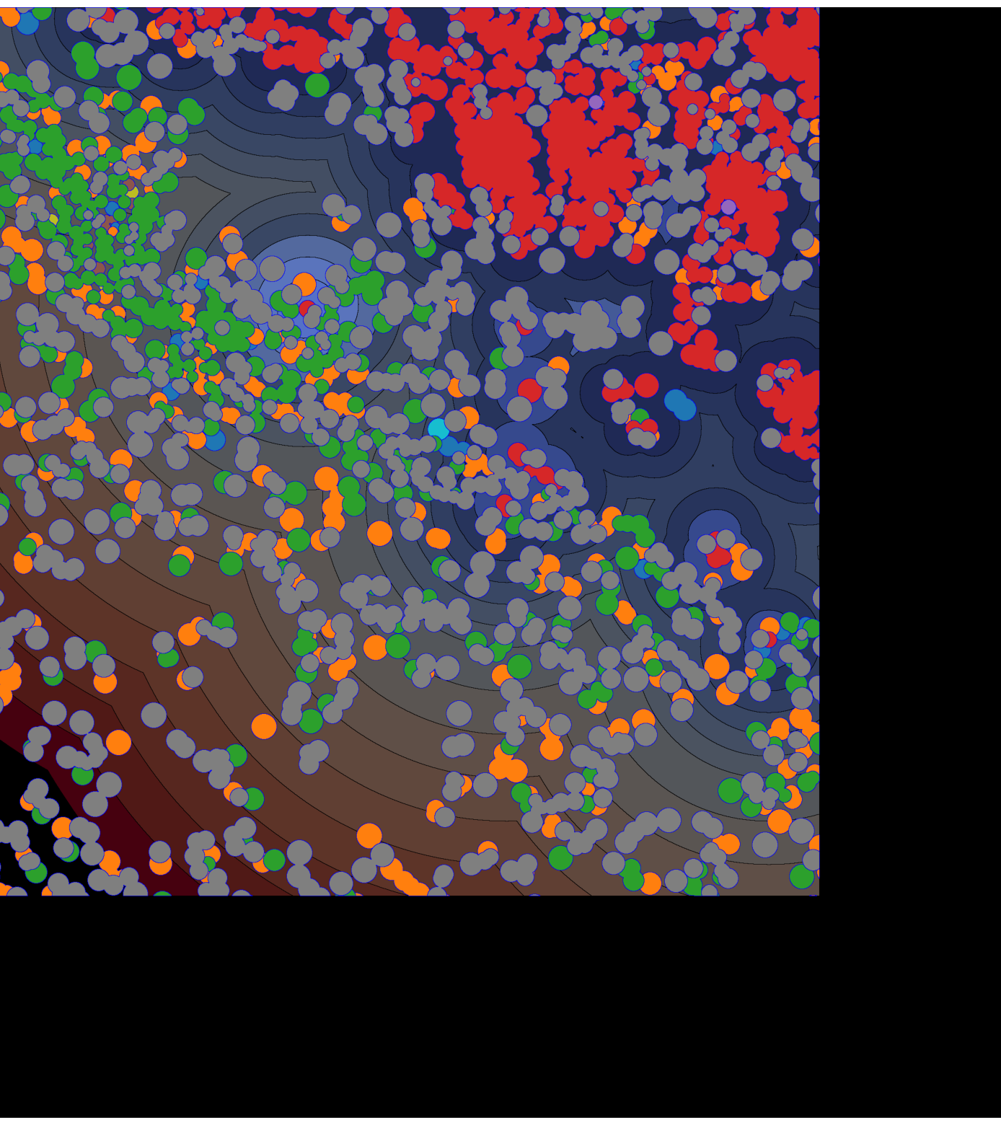
DBSCAN Spatial Analysis
Clustering immune cells
Identifying tumor–immune micro-regions
Quantifying cluster sizes, densities
Running at ROI-level and slide-level

Slide 18
Slide-Level Statistics
N cells
Mean cells per tile
Cell size distribution
Fraction per cell type
Per-class proba support

Slide 19
Summary of Achievements
✔ Full data engineering pipeline for ImmuCAN
✔ Full QPTIFF image I/O and ROI support
✔ Full tissue mask + cell mask pipeline
✔ TSV integration & phenotype conversion system
✔ Full cell table extraction
✔ Colocalisation + DBSCAN + statistics
✔ Adapted DeepCellMap to run on a new dataset

Slide 20
Conclusion and Future work
DeepCellMap now works on ImmuCAN Specefic ROI
We created a new version of the entire pipeline
Results ready for downstream biomarker discovery
In next Work we try to apply at scale to full image and then full cohorts
There is problem with borders which cused black border in 2 side of th images that we will work on to fix it

Slide 21
Thanks for your Attention!
Special Thanks to Theo Perochon , Jing Liu and Matteo Cesaronni and All of my teammates that share a lot of time together and learn a lot from them ☺

